Slide 1
The 8251A - USART
Lecture 2

Slide 2
Motivation
Data I/O is a vital component in almost all Embedded Systems/ Embedded Design projects
Data is communicated between the controller/ processor and the external world through various communication protocols and interfaces that handle these protocols
The 8251A is a programmable serial communication interface chip designed for synchronous and asynchronous serial data communication.
There are other kinds of communication interfaces such as 8255 that was popularly used as a parallel interface for transferring data from a processor to outside world

Slide 3
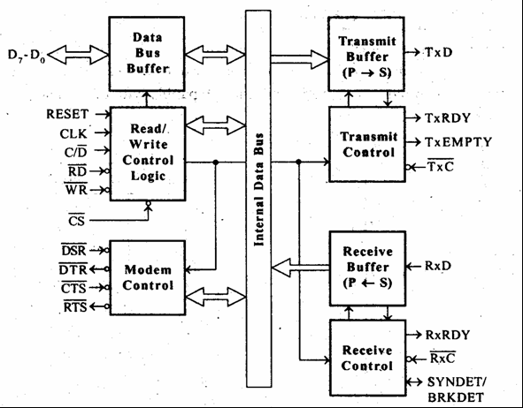
An Overview
The 8251A Functional Block Diagram

Slide 4
An Overview
Read/Write control logic:
The Read/Write Control logic interfaces the 8251A with CPU, determines the functions of the 8251A according to the control word written into its control register.
The active low signals RD, WR, CS and C/D(Low) are used for read/write operations with the control register, status register and the transmit and receive buffers.
When C/D’ is high, the data written to the data buffer lands up at the control register or the data from the status register of the USART is read via the data buffer
When C/D’ is low, the data written to the data buffer is appears on the Transmit Buffer or the data at the Receive Buffer is read via the data buffer.
When the reset is high, it forces 8251A into the idle mode.

Slide 5
An Overview
Transmitter section:
The transmitter section accepts parallel data from CPU and converts them into serial data.
The transmitter section is double buffered, i.e., it has a buffer register to hold an 8-bit parallel data and another register called output register to convert the parallel data into serial bits.
When output register is empty, the data is transferred from buffer to output register. Now the processor can again load another data in buffer register.
If buffer register is empty, then TxRDY is goes to high.
If output register is empty then TxEMPTY goes to high.
The clock signal, TxC (low) controls the rate at which the bits are transmitted by the USART.
The clock frequency can be 1,16 or 64 times the baud rate.

Slide 6
An Overview
Receiver Section:
The receiver section accepts serial data and convert them into parallel data
The receiver section is double buffered, i.e., it has an input register to receive serial data and convert to parallel, and a buffer register to hold the parallel data.
When the RxD line goes low, the control logic assumes it as a START bit, waits for half a bit time and samples the line again.
If the line is still low, then the input register accepts the following bits, forms a character and loads it into the buffer register.
The CPU reads the parallel data from the buffer register.
When the input register loads a parallel data to buffer register, the RxRDY line goes high indicating the processor that it can read the data. The clock signal RxC (low) controls the rate at which bits are received by the USART.

Slide 7
Data Buffer, Reset Description
3 State, bidirectional, interfaces 8251A to the Processor Data Bus
Data is transmitted out of the processor and into the processor by the Data Buffer
The mode command and status bytes are also written and read from through the data buffer
A high on the RESET pin send the device into idle mode
It continues in idle mode until a new command is written to the device
A software or programmable reset is also possible through the command byte

Slide 8
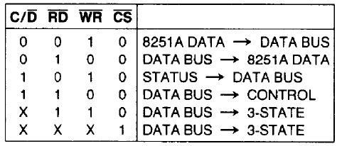
Command/Data, Read and Write Description

Slide 9
Transmitter Section
Transmitter Buffer:
Accepts parallel data from data buffer, frames the data with appropriate start, stop and parity bits based on the command byte.
Sends the data to output buffer where the data is serialized
Send the serialized data out on the TxD pin
TxRDY (Transmitter Ready):
Signals the processor that the USART is ready to accept a character or byte
Goes High when Transmitter Buffer is empty
TxEmp (Transmitter Empty):
Goes high when output buffer is also empty. Note that this implies that transmit buffer is also empty, since if there was data in the transmit buffer it is automatically shifted into output buffer if it is empty

Slide 10
Receiver Section

